Slide 1
A Transformer-based Approach to Analyzing COVID-19 Vaccine Sentiment and Emotion
Daniel Cisek, Jacob McIntosh, Ercong Luo, Jiaying Zhuang

Slide 2
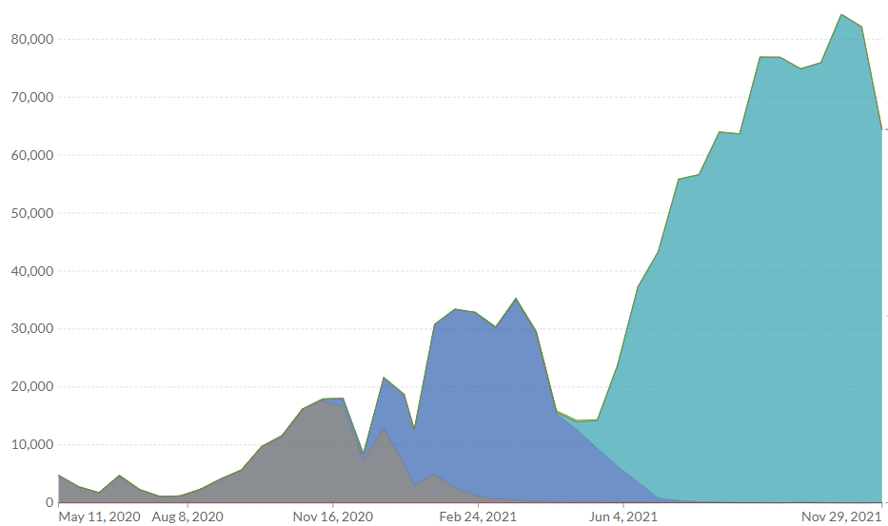
Background
COVID-19 is evolving (Alpha, Delta, Omicron), along with public sentiment towards vaccines
Assessing public sentiment is a key driver of success for:
Governments
Global Health Organizations
Medical Professionals
Delta
“Spreading this information can strongly influence people’s behavior and alter the effectiveness of the countermeasures deployed by governments”
Cinelli, 2020
Alpha

Slide 3
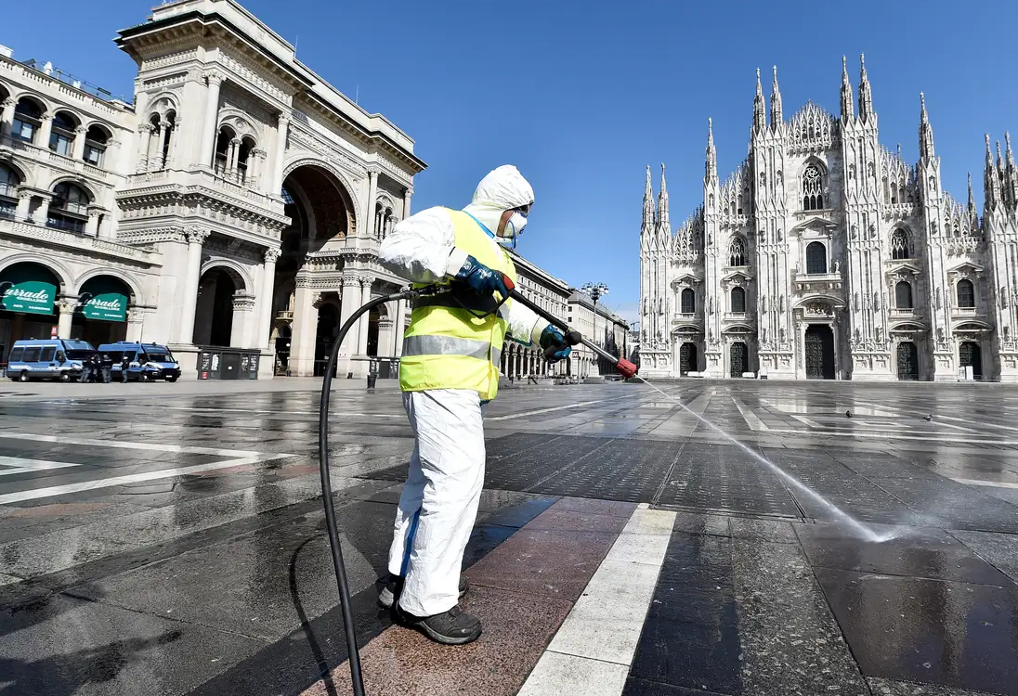
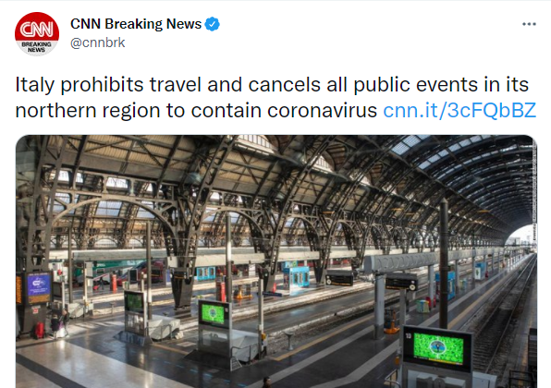
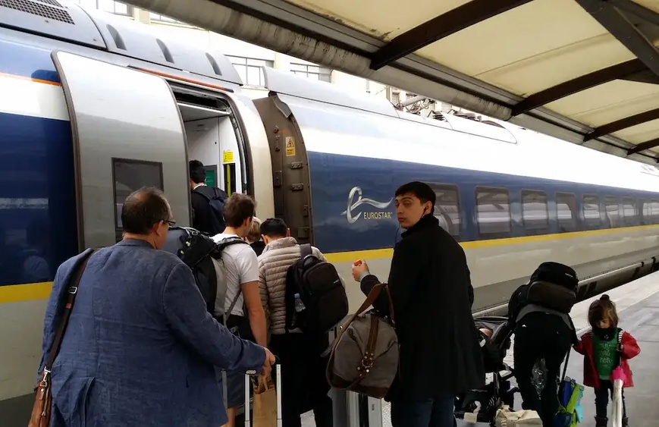

Lombardy, Italy: March 2020
February - March, 2020
March 8, 2020: Morning
March 8, 2020
March 8, 2020: Evening
Exodus from Lombardy
COVID-19 Ravages Lombardi, Italy
CNN Rumors about Lombardy Closure
Italian PM Announces Lockdown
Many left Lombardy ahead of lockdown, worsening the spread of COVID-19
The virus spreads quickly, with nearly a third of national cases occurring here
A rumor went viral, igniting fears of a region-wide lockdown in Italy
Hours after the rumors started, the PM announced the official closure of Lombardy

Slide 4
Goals & Objectives
Train a BERT model to assess public emotion and sentiment on Twitter conscerning COVID-19 Vaccines in the United States
Construct an API to enable rapid ingest and interpretation of real-time tweets on this topic
Case Study: Investigate the emergence of the Omicron variant of COVID-19 in the United States, visualize its effects on Twitter-based public emotion, and provide resources to enable future research

Slide 5

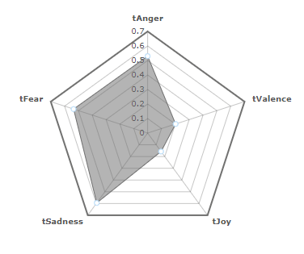
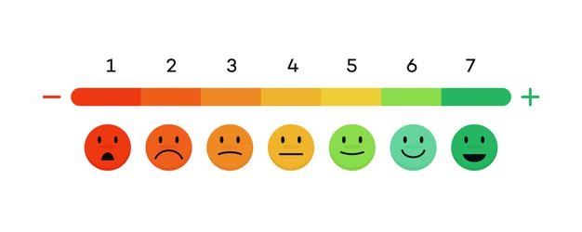
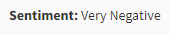

Data
Utilized Twitter data collected by Singapore’s Agency for Science, Technology and Research (A*STAR)
Contains over 198 million tweets retrieved with the keywords “corona”, “wuhan”, “nCov”, or “covid”
Calculated emotions and sentiments in tweets with CrystalFeel, a Multi-dimensional Emotion Analyser
Best efforts yielded accurate results only 70%-80% of the time
“COVID is the worst”

Slide 6
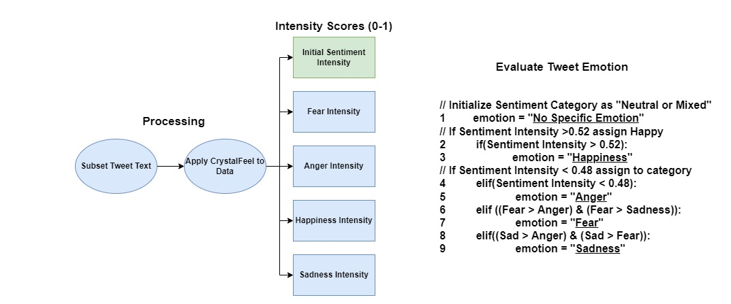
Processing Emotions
Low Intensity: COVID is kind of a bummer
High Intensity: COVID IS THE WORST!!!

Slide 7

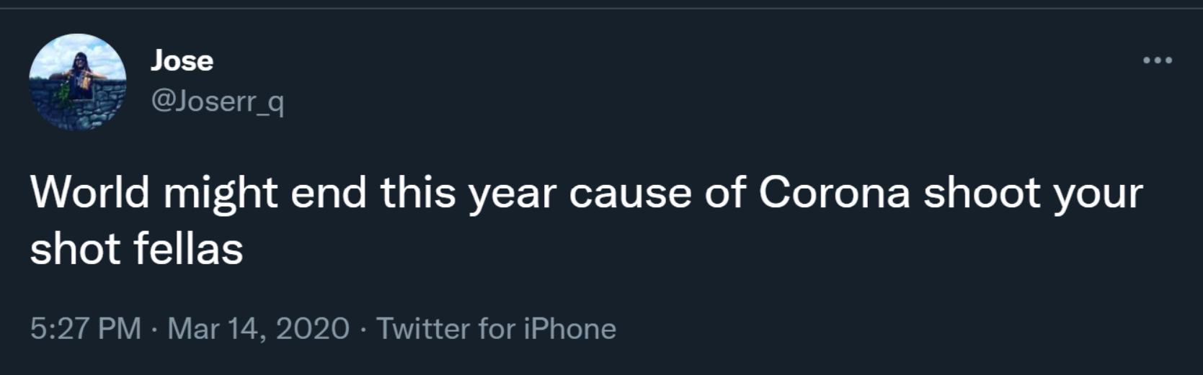


Labeled Data Examples
Sadness
Fear
Anger
Happiness

Slide 8
BERT TOKENIZER

Slide 9
WORDPIECE EMBEDDING
Embedding Lookup Table
“Hello”
“Hello”
30,000+
[ 0.359 , -1.494 , 0.334 , … , 0.4367 , 1.234 , 0.002 ]
768
768

Slide 10
TOKENIZING SENTENCES
Embedding Lookup Table
‘I’
“I like to draw”
“to”
[ ‘I' , 'like' , 'to', 'draw' ]
‘like’
‘draw’
[ 146 , 1176 , 1106 , 3282 ]

Slide 11
SPECIAL TOKENS ( [CLS] and [SEP] )
[SEP] token is inserted at the end of a singular input
[CLS] is a classification token inserted at the beginning of an input
Used in final hidden state of BERT for classification
“I like to draw”
[ ‘[CLS]’ , ‘I' , 'like' , 'to', 'draw' , ‘[SEP]’ ]
[101 , 146 , 1176 , 1106 , 3282 , 102 ]

Slide 12
SUBWORDS
“This sentence is an embedding”
[ ‘This’ , ‘sentence’ , ‘is’ , ‘an’ , ‘?????’ ]
[ '[CLS]' , 'This' , 'sentence' , 'is' , 'an', 'em' , '##bed' , '##ding' , '[SEP]' ]
[ 101 , 1188 , 5650 , 1110 , 1126 , 9712 , 4774 , 3408 , 102 ]

Slide 13
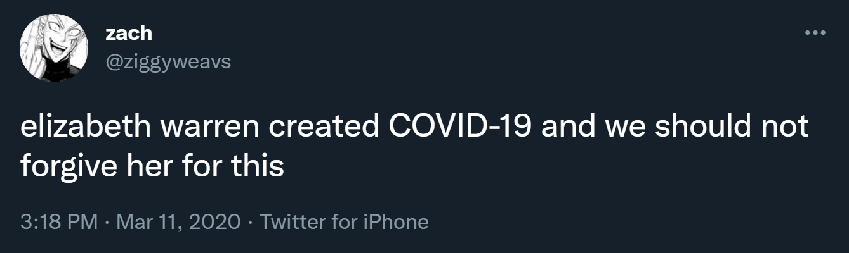
TOKENIZING A REAL TWEET
[ '[CLS]' , 'el' , '##iza' , '##beth' , 'war' , '##ren' , 'created' , 'CO' , '##VI' ,
'##D' , '-' , '19' , 'and' , 'we' , 'should' , 'not' , 'forgive' , 'her' , 'for' , 'this' , '[SEP]' ]
[ 101 , 8468, 23228 , 16100 , 1594 , 5123 , 1687 , 18732 , 23314 , 2137 , 118 , 1627 , 1105 , 1195 , 1431 , 1136 , 10737 , 1123 , 1111 , 1142 , 102 ]

Slide 14
BERT STRUCTURE
ML Buzzword: #TransferLearning

Slide 15
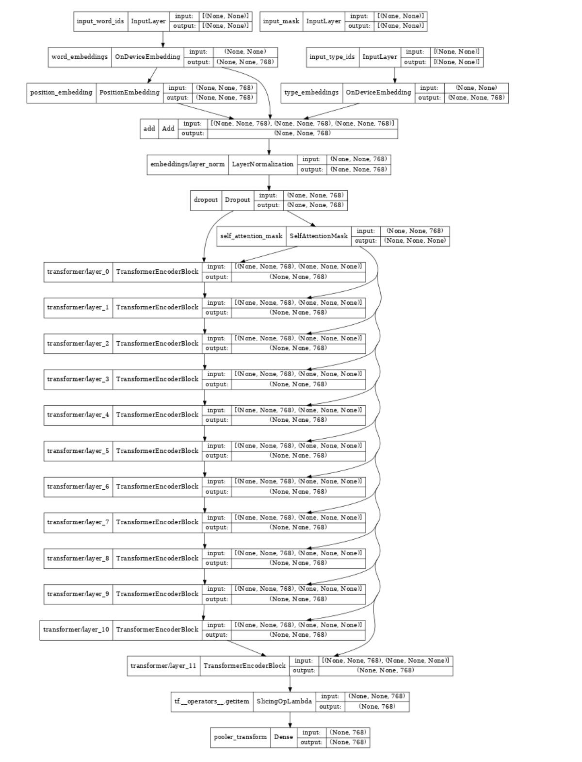
BERT: Bidirectional Encoder Representations from Transformers
Institution: Google Research (original paper)
Architecture: what happens from a string of text to an output predicted label?
String → word IDs (BERT tokenization)
word IDs in sequence → embeddings
BERT has a vocabulary that consists of {word → real number vector} pairs.
Embeddings reflect: similarity in word meaning
Embeddings (768-tuple vectors) → 12 Transformer Layers. Each layer has:
Self-attention: capture word contexts in addition to individual word meanings
Feedforward NN: output adjusted embeddings based on context for each word
-------------------------------------- ALL Above is Pre-Trained --------------------------------------
Last Layer: customize depending on the task (#Transfer Learning)
Visualization of BERT structure to the right
Embedding layers
-----
represent word meanings and positions numerically
12 Transformer
Layers (attention + feedforward NN)
-----
Encode context and word meanings numerically
Task dependent output layers

Slide 16
BERT: what is transfer learning?
Pre-training for these “fake tasks” using very large datasets.
Masked Word Prediction
Next Sentence Prediction
The design of these tasks is such that they:
don’t need to be feasible tasks, all we want to do is training the parameters in the encoder
require little data engineering on the training dataset so that large corpuses can be used
Fine tuning: all that’s needed is feeding a small (relative to pre-training) dataset with task-specific labels.
no pre-training needed again.
Pre-trained transformer layers can already capture sufficient language meaning
Customize the last layer depending on task.
For the purpose of our project:
Text → (BERT-base, pre-trained deep encoder) → (sentiment category outputs in last layer) → output sentiment label

Slide 17
BERT: pros and cons of the model.
Pros, because the model is pretrained:
Less data (~100 MBs/GBs) required to deploy a large NLP model like BERT
Quicker development cycle
Better results than training a smaller model from scratch
Limitations:
Because BERT is a large model (more than 100M weights in embedding and transformer layers):
Slow inference (difficult to run locally on laptops and smartphones)
Slow training (we used Google Colab Pro to train on a dataset ~ GBs)
BERT underperforms when lots of jargons are involved.
Suited Tasks:
Classification (our project), Named Entity Recognition, Part-of-Speech Tagging, Question Answering
Unsuited Tasks:
Language Modeling, Text Generation (e.g. translation)

Slide 18
Fine Tuning

Slide 19
Fine Tuning
Dataset
A*STAR COVID Dataset
Annotated dataset: labels {0-fearful, 1-angry, 2-happy, 3-sad, 4-neural}
Backprop training on Google Collab Pro
Backpropagation
Pre-trained weights are still updated in backprop on fine tuning dataset
Sentiment Analysis Project Workflow
legends:
dataset
model
Validation Dataset
(labeled by hand)
Give Model Performances Evaluations
inference
BERT-base
Fine Tuned
BERT-base
inference
Real-Time Twitter Data collected using API
(unlabeled)
Case Study on COVID Vaccine Sentiments
Fine tune
Combined
with
FastAPI
Demo on Individual Text chunks
A*STAR Labeled Dataset
Deliverables

Slide 20
TRAINING AND EVALUATION

Slide 21
BERT BASE UNCASED
Batch Size: 32
Epochs : 6
Learning Rate: 3e-5
Training Loss : 0.73555
Training F1 Score : 0.70361
Training Accuracy : 0.70515
 | Fear | Anger | Happiness | Sadness | No Specific Emotion
Fear | 31167 | 2966 | 354 | 2491 | 4171
Anger | 5068 | 27336 | 414 | 3968 | 3646
Happiness | 454 | 522 | 34854 | 976 | 8438
Sadness | 2835 | 2075 | 661 | 35313 | 2171
No Specific Emotion | 5236 | 4113 | 7539 | 4273 | 22887

Slide 22
BERT BASE UNCASED EVALUATION
Testing Loss : 0.79672
Testing F1 Score : 0.67327
Testing Accuracy : 0.67472
Preprocessing and Cleaning had minimal impact on the accuracy
 | Fear | Anger | Happiness | Sadness | No Specific Emotion
Fear | 3394 | 365 | 59 | 411 | 513
Anger | 577 | 2776 | 54 | 485 | 425
Happiness | 64 | 90 | 3687 | 147 | 983
Sadness | 319 | 250 | 102 | 3851 | 291
No Specific Emotion | 659 | 512 | 931 | 522 | 2405

Slide 23
BERT BASE CASED
Batch Size: 32
Epochs : 6
Learning Rate: 3e-5
Training Loss : 0.6111
Training F1 Score : 0.76286
Training Accuracy : 0.76449
 | Fear | Anger | Happiness | Sadness | No Specific Emotion
Fear | 32893 | 2322 | 175 | 3107 | 3552
Anger | 3972 | 29448 | 289 | 3557 | 3166
Happiness | 207 | 305 | 37462 | 635 | 6635
Sadness | 1775 | 1342 | 380 | 37971 | 1557
No Specific Emotion | 3765 | 3231 | 6936 | 3580 | 26536

Slide 24
BERT BASE CASED EVALUATION
Testing Loss : 0.77055
Testing F1 Score : 0.68308
Testing Accuracy : 0.68414
Preprocessing and Cleaning had minimal impact on the accuracy
 | Fear | Anger | Happiness | Sadness | No Specific Emotion
Fear | 3390 | 359 | 45 | 417 | 531
Anger | 537 | 2753 | 68 | 511 | 448
Happiness | 46 | 72 | 3717 | 152 | 980
Sadness | 283 | 255 | 94 | 3910 | 280
No Specific Emotion | 542 | 472 | 944 | 503 | 2568

Slide 25
VALIDATION

Slide 26
Creating a Validation Dataset
Constructing a validation set to benchmark and assess model results is key to understanding model strengths and weakness prior to deployment
Used the Twitter API to collect 300 English-based tweets that contained the keywords “covid vaccine”, “moderna vaccine”, or “pfizer vaccine”
Hand-labeled these tweets for emotion to have ground truth data against which to compare the fine-tuned model
NEW—Pfizer and BioNTech are expected this week to apply for regulatory approval for a booster shot of their coronavirus vaccine for 16- and 17-year-olds. If approved, the shot would be the first booster available to people under 18.
The hostage-taking by Moderna and Pfizer—who refuse to share the technology for their potent vaccine mRNA platforms to allow faster and more extensive global manufacture and production—[is] endangering us all by their greed.

Slide 27
Validation Results
Validation Loss : 1.80224
Validation F1 Score : 0.36503
Validation Accuracy : 0.40404
The model had issues with falsely labeling Tweets with No Specific Emotion as either showing Fear or Happiness
 | Fear | Anger | Happiness | Sadness | No Specific Emotion
Fear | 5 | 1 | 0 | 0 | 1
Anger | 8 | 15 | 4 | 1 | 3
Happiness | 6 | 2 | 16 | 1 | 10
Sadness | 3 | 0 | 3 | 3 | 1
No Specific Emotion | 30 | 13 | 27 | 4 | 41

Slide 28
Omicron: A Case Study

Slide 29
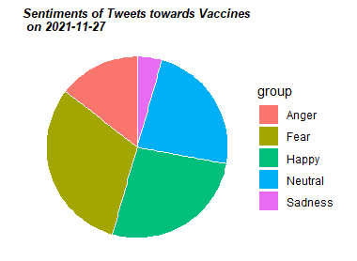
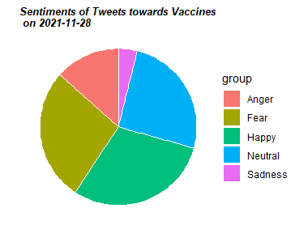
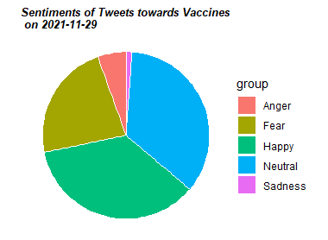

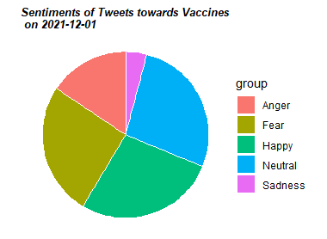
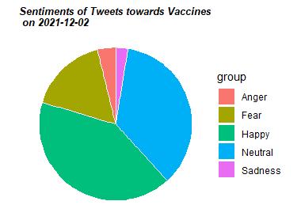
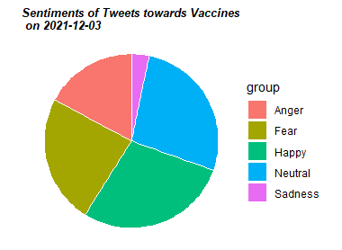

Daily Sentiment Composition

Slide 30
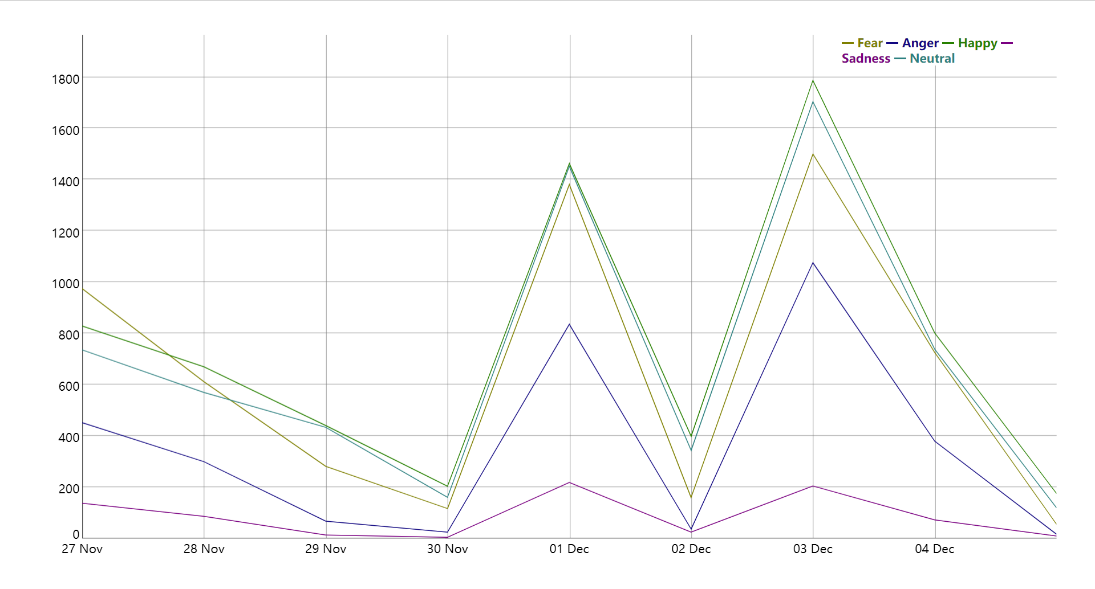
Weekly Sentiment Trend
https://jiayingzhuang.georgetown.domains/SentimentGraph.html

Slide 31
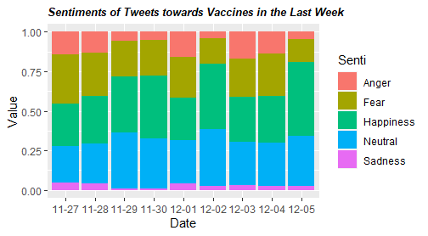
Weekly Sentiment Trend

Slide 32

Omicron News: Center for Disease Control (CDC)
Fear: +3%⬆
Sadness: +4%⬆
Happiness: -13%⬇
Anger: +11%⬆
https://jiayingzhuang.georgetown.domains/SentimentGraph.html

Slide 33
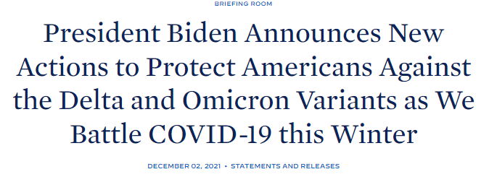
Omicron News: White House
Fear: -9%⬇
Sadness: -2%⬇
Happiness: +14%⬆
Anger: -12%⬇
“The United States has come far in its fight against the virus ...We have more tools today to fight the Omicron variant than we have had to fight previous variants …The President is committed to using every resource and tool available”
https://jiayingzhuang.georgetown.domains/SentimentGraph.html

Slide 34

Omicron News: New York Times
Fear: +8%⬆
Sadness: +1%⬆
Happiness: -12%⬇
Anger: +13%⬆
https://jiayingzhuang.georgetown.domains/SentimentGraph.html

Slide 35
FAST API Demo

Slide 36
References 1/2
[1] Cinelli, M., Quattrociocchi, W., Galeazzi, A. et al. The COVID-19 social media infodemic. Sci Rep 10, 16598 (2020). https://doi.org/10.1038/s41598-020-73510-5 [2] John, T.,; Wedeman, B. (2020, March 8). Italy prohibits travel and cancels all public events in its northern region to contain coronavirus. CNN. Retrieved from https://www.cnn.com/2020/03/08/europe/italy-coronavirus-lockdown-europe-intl/index.html. [3] Gupta, Raj Kumar, Ajay Vishwanath, and Yinping Yang. "COVID-19 Twitter dataset with latent topics, sentiments and emotions attributes." arXiv e-prints (2020): arXiv-2007. [4] Wilson SL, Wiysonge C. Social media and vaccine hesitancy. BMJ Global Health 2020;5:e004206. [5] Zapan Barua, Sajib Barua, Salma Aktar, Najma Kabir, Mingze Li, Effects of misinformation on COVID-19 individual responses and recommendations for resilience of disastrous consequences of misinformation, Progress in Disaster Science, Volume 8, 2020, 100119,ISSN 2590-0617, https://doi.org/10.1016/j.pdisas.2020.100119. [6] Babajide Osatuyi, Information sharing on social media sites, Computers in Human Behavior, Volume 29, Issue 6, 2013, Pages 2622-2631, ISSN 0747-5632, https://doi.org/10.1016/j.chb.2013.07.001. [7] Alamoodi AH, Zaidan BB, Zaidan AA, et al. Sentiment analysis and its applications in fighting COVID-19 and infectious diseases: A systematic review. Expert Syst Appl. 2021;167:114155. doi:10.1016/j.eswa.2020.114155 [8] Bert Research - EP. 1 - key concepts & sources. BERT Research - Ep. 1 - Key Concepts & Sources · Chris McCormick. (2019, November 11). Retrieved from https://mccormickml.com/2019/11/11/bert-research-ep-1-key-concepts-and-sources/. [9] Horev, R. (2018, November 17). Bert explained: State of the art language model for NLP. Medium. Retrieved from https://towardsdatascience.com/bert-explained-state-of-the-art-language-model-for-nlp-f8b21a9b6270. [10] Kim, L., Fast, S. M. & Markuzon, N. Incorporating media data into a model of infectious disease transmission. PLoS ONE 14, 1 (2019).

Slide 37
References 2/2
[11] WHO Situation Report 13. https://www.who.int/docs/default-source/coronaviruse/situation-reports/20200202-sitrep-13-ncov-v3.pdf?sfvrsn=195f4010_6
[12] Devlin.J, Chang Ming-Wei et al. BERT: Pre-Training of Deep Bidirectional Transformers for Language Understanding. https://arxiv.org/pdf/1810.04805.pdf
[13] SARS-COV-2 variants in analyzed sequences. Our World in Data. (n.d.). Retrieved December 5, 2021, from https://ourworldindata.org/grapher/covid-variants-area?country=~GBR.
[14] Crystalfeel - multidimensional emotion intensity analysis from natural language. (n.d.). Retrieved December 5, 2021, from https://socialanalyticsplus.net/crystalfeel/.
[15] The United States Government. (2021, December 3). President Biden announces new actions to protect Americans against the Delta and Omicron variants as we battle COVID-19 this Winter. The White House. https://www.whitehouse.gov/briefing-room/statements-releases/2021/12/02/fact-sheet-president-biden-announces-new-actions-to-protect-americans-against-the-delta-and-omicron-variants-as-we-battle-covid-19-this-winter/.
[16] Tensorflow Notebook: Fine-tuning a BERT model

Slide 38
Thanks for Listening!
– Q&A –
Group GitHub Page:
https://github.com/ErcongLuo/GU_ANLY580_FinalProject

